Slide 1
Open Cap vs Tracker
Kai Jen, Ian, Kevin

Slide 2
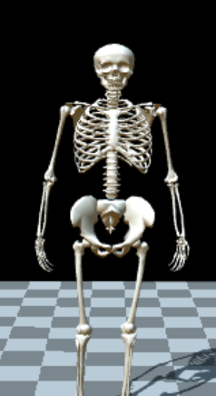
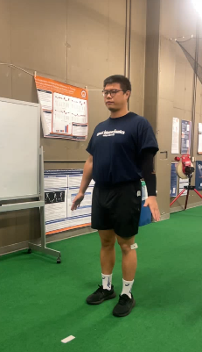
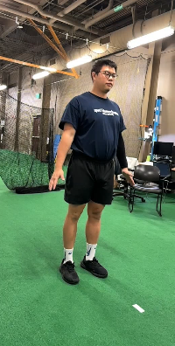
Open Cap Setup
2 iPhone’s capturing at 60 frames per second.

Slide 3
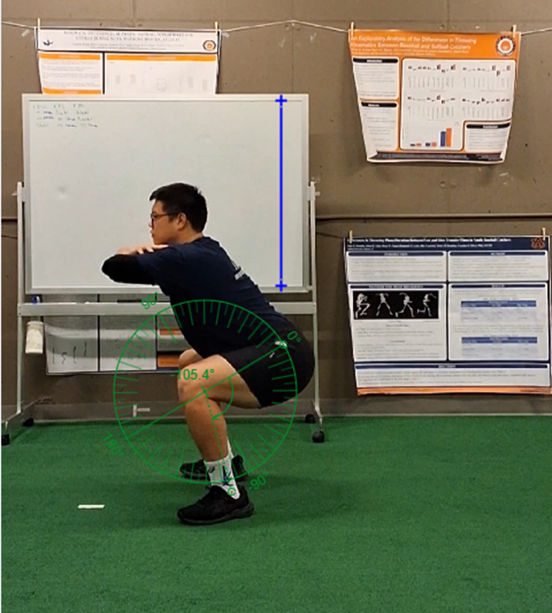
Tracker Setup
1 iPad capturing at 60 frames per second.
The squats were filmed perpendicular to the sagittal plane, facing the left side of the individual.

Slide 4
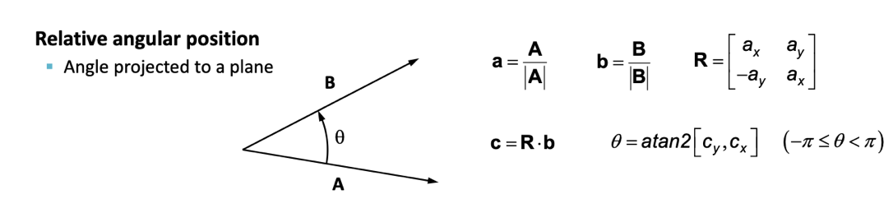
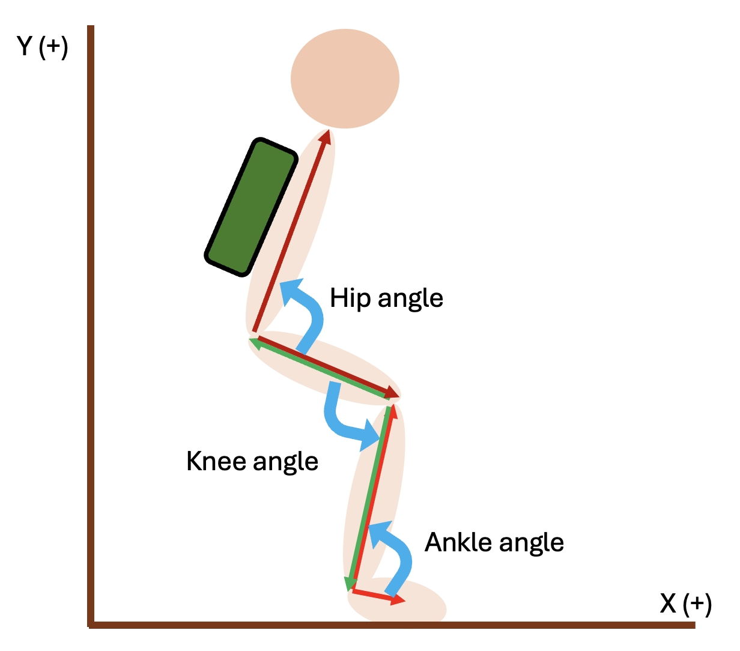
Method – set up
Calibration: Followed OpenCap instructions.
Recording: Videos were captured with markers on the hip, knee, and ankle for tracker
Trials: Three squat trials were performed with hands crossed over the chest.
Filtering: 4th-order zero-lag Butterworth low-pass filter
Cutoff Frequency: Set at 6 Hz.
Event Definition:
Event 1: The hip joint position drops below the stance posture
(calculated as the average of the first five frames).
Event 2: The hip joint position returns below the stance posture after Event 1.
Time Normalization: Each trial was resampled to 100 frames.
Knee Angle Calculation: Relative angles were used.
Knee flexion / extension

Slide 5
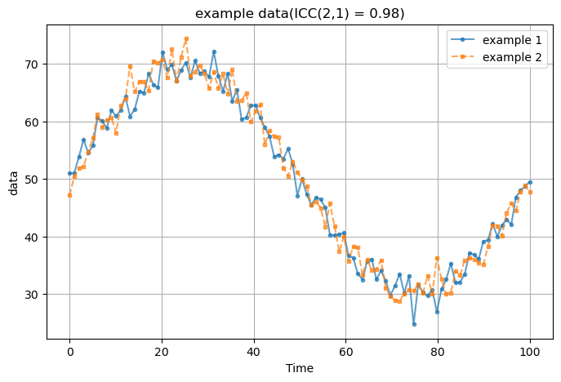
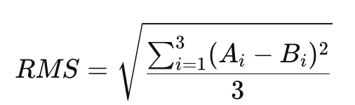
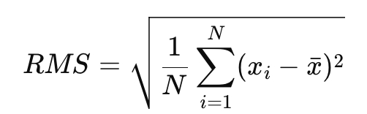
Method – analysis data
Comparison
rms of the Max knee flexion-angle of each trail
open cap vs tracker
Within trails ( open can tracker)
ICC (ICC(2,1) - Two-Way Random, Absolute Agreement)

Slide 6
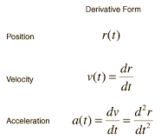
Method – linear kinematics
Export csv data from OpenCap
Vertical jump data
Variables: position data of (X, Y, Z)
Process – python
Interpolation: cubic polynomial method
Filtering: 4th-order zero-lag Butterworth low-pass filter (cutoff = 6Hz)
Linear velocity and acceleration : time derivative

Slide 7

Maximum Knee Flexion Angle
Open Cap
Squat 1 = 89.79
Squat 2 = 87.21
Squat 3 = 82.56
Tracker
Squat 1 = 105.80
Squat 2 = 102.74
Squat 3 = 97.09

Slide 8
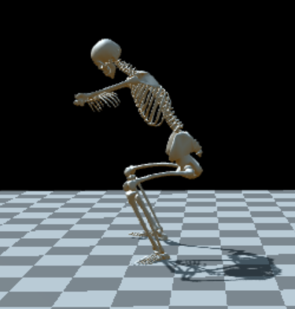

Open Cap vs Tracker (squat 1)

Slide 9
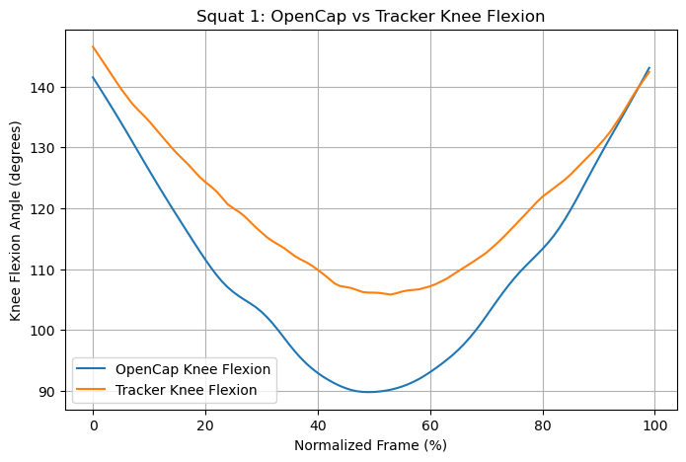
Open Cap vs Tracker Results

Slide 10
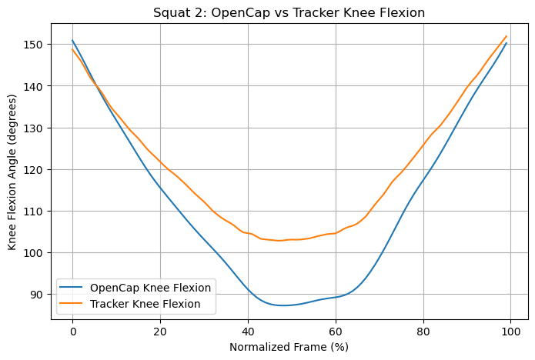
Open Cap vs Tracker Results

Slide 11
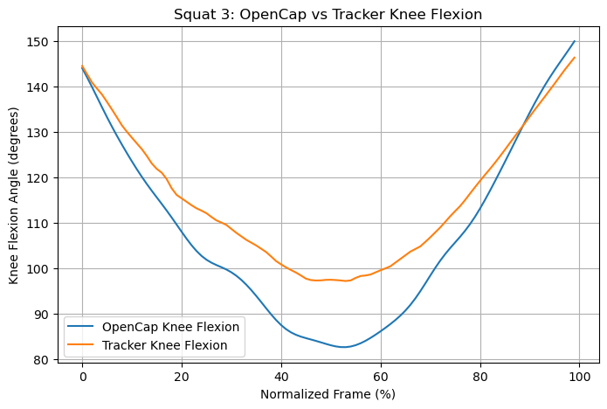
Open Cap vs Tracker Results

Slide 12
Open Cap vs Tracker
RMS for knee flexion angle: 15.4°
ICC for squat 1: 0.74 (Moderate agreement)
ICC for squat 2: 0.85 (Good agreement)
ICC for squat 3: 0.87 (Good agreement)

Slide 13
Open Cap RMS for Knee Flexion Angles
Squat 1 RMS = 2.32°
Squat 2 RMS = 2.16°
Squat 3 RMS = 2.68°
Average RMS = 2.39°

Slide 14
Tracker RMS for Knee Flexion Angles
Squat 1 RMS = 3.03°
Squat 2 RMS = 1.86°
Squat 3 RMS = 3.44°
Average RMS = 2.78°

Slide 15
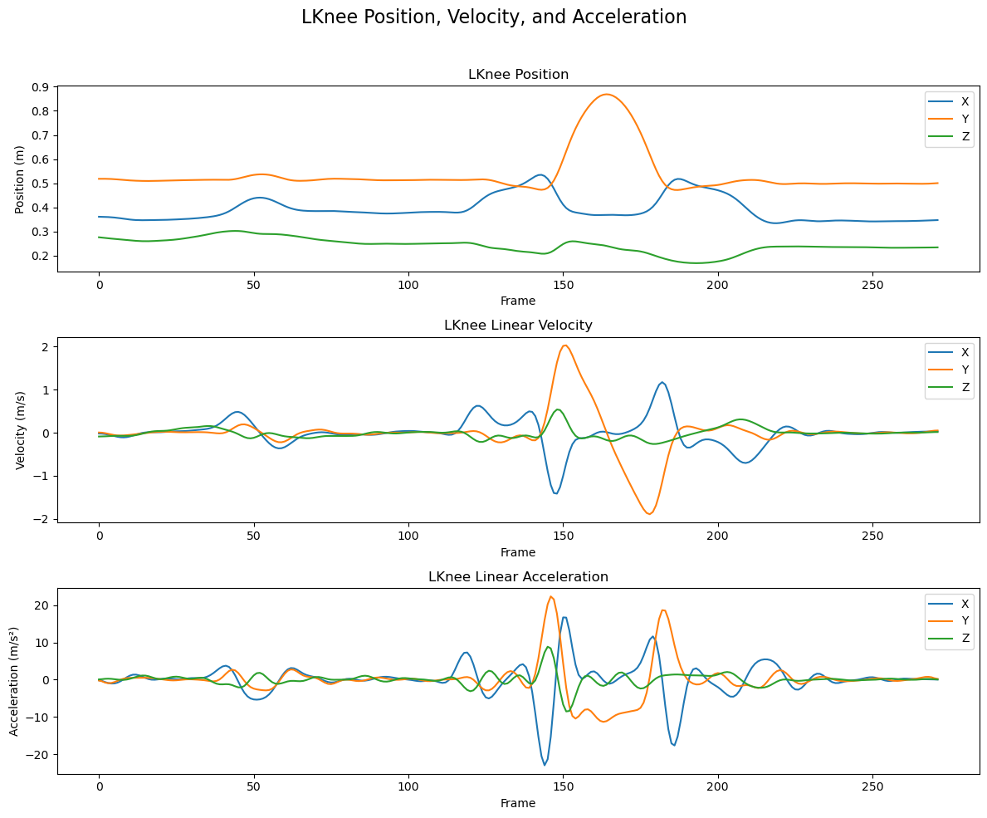
Vertical Jump on Open Cap

Slide 16
Key Take Aways
When comparing open cap to tracker, they seem to have good agreement and reliability (0.74-0.87).
The high RMS (15.4°) between the 2 devices could be due to the differences in tracked joint positions.
Overall, the RMS for each individual motion capture showed low variability for the squats.
Open Cap average = 2.39°
Tracker average = 2.78°

Slide 17

Thank you
< - Link for the code – Please feel free to use

